Slide 1


Technical Report Case Studies
Data Structures & Algorithms
You must choose One of the following 3 case studies. They are equally difficult to score well in, but some are less reliant on programming and more reliant on an understanding of data structures to score highly. Start planning from this week, Do Not leave it until the week before to choose and try and solve as the teaching team won’t be able to support you along with everybody else.

Slide 2
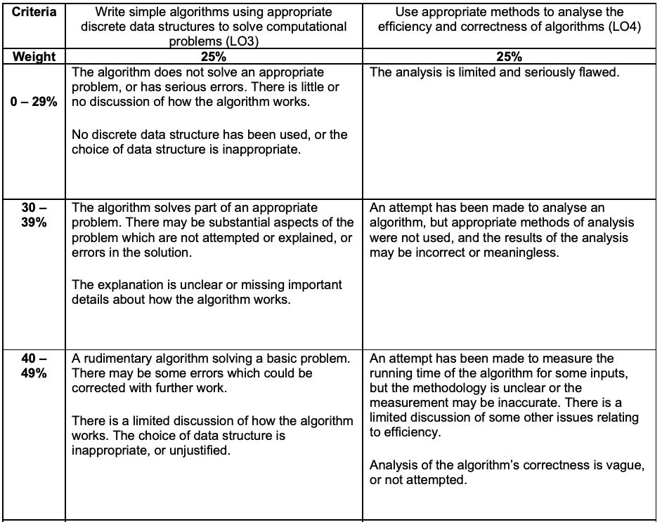
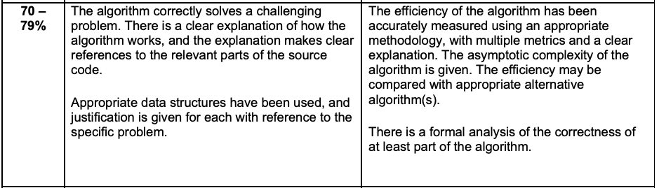
Marking Breakdown
Data Structures & Algorithms
Time will be set aside each week in the labs to answer questions, but don’t treat this as a fixed question to answer. You can be creative and make the problem more complex or delve further into the theoretical side to find a better or more realistic solution. Good answers will introduce several references and discuss the ethical implications of the proposed algorithms.

Slide 3
1. Rankings Galore
Search, Sorting Algorithm
University rankings have a significant impact on student choices and journalists must present survey results and write opinion pieces to recommend where prospective learners should study. As an analyst at Times Higher Education you have been asked to prepare data for a journalist using searching and sorting algorithms. An example of the survey results is shown below and the colab file for this case study will demonstrate how to import the data.
Index | University name | Overall score | Entry standards | Student satisfaction | Research quality | Research intensity | Graduate prospects
1 | Bath Spa University | 84% | 37% | 80% | 67% | 29% | 0%
2 | University of Chichester | 80% | 42% | 75% | 0% | 0% | 0%
3 | Canterbury Christ Church University | 76% | 40% | 70% | 0% | 0% | 49%
4 | Buckinghamshire New University | 78% | 39% | 82% | 0% | 0% | 52%

Slide 4
Requirements for code
Edit a standard sorting algorithm to compare a specific key from each of the nested list elements. Hint: lst[3][2] accesses the 3rd element of the 4th list.
Using selection sort order lst2 by student satisfaction. The journalists want to write about the 40 universities with highest satisfaction.
Write a linear search algorithm to find where a specific university is within these 40.
Implement an efficient sorting algorithm to arrange universities by name (ignore any starting with ‘university of…’ so University of Bath would be before Birmingham City University
Implement an efficient search algorithm to find how many universities have satisfaction > 85%.
Comment why you have used this data structure and justification for using it

